Slide 1
Skill Gap Analysis : Are Job Seekers Truly Industry-Ready?
By : Sanjana Prithviraj

Slide 2
INTRODUCTION
In today’s competitive job market, employers seek candidates who are not only qualified on paper but also industry-ready in terms of practical skills, confidence, and communication.
This project, Skill Gap Analysis, is designed to assess how well job seekers align with industry expectations based on their self-assessment across various skill areas.
By analyzing survey data collected from aspiring professionals, we aim to uncover patterns, gaps, and actionable insights that can guide training programs and career development initiatives.

Slide 3
OBJECTIVES
Identify Skill Gaps : Assess the gap between self-rated skills of individuals and the expectations of the job market.
Analyze Key Skill Areas : Evaluate technical skills, communication skills, and interview confidence across different domains.
Domain-wise Comparison : Compare average skill ratings across various fields of interest (e.g., Data Science, Web Development, etc.).
Provide Insights for Career Readiness : Generate actionable insights to help learners and educators align better with industry needs.
Support Data-Driven Decision Making : Use visualizations and statistics to inform training, mentoring, and upskilling programs.

Slide 4
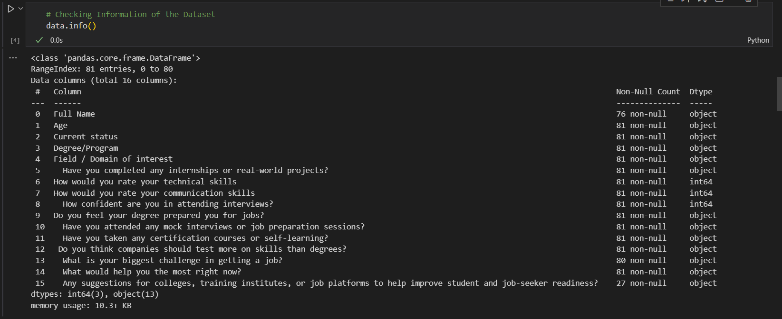
DATASET OVERVIEW
BASIC DETAIL
SCREENSHOT
Dataset Name: Skill Gap Analysis Dataset
2. Source: Collected via survey responses from learners in various domains.
3. Number of Records: 81 rows (participants)
4. Number of Features: 14 columns (including domain interest, skill ratings, certifications, etc.)
5. Data Types: Numerical: Skill ratings (scale 1 to 5)
Categorical: Domain, Certifications, Projects, etc.

Slide 5
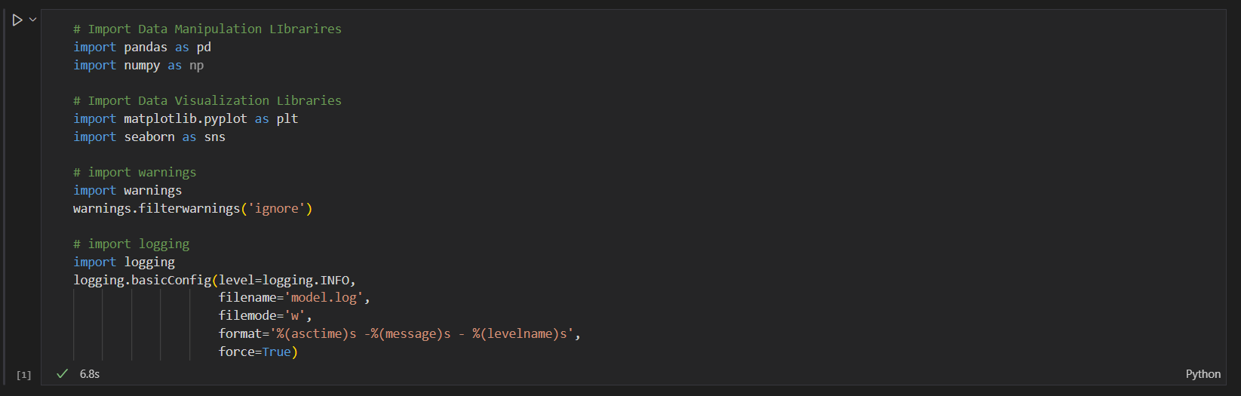
TOOLS AND LIBRARIES USED
pandas – for data manipulation
numpy – for numerical operations
seaborn & matplotlib – for data visualization
sklearn – for preprocessing (SimpleImputer)

Slide 6
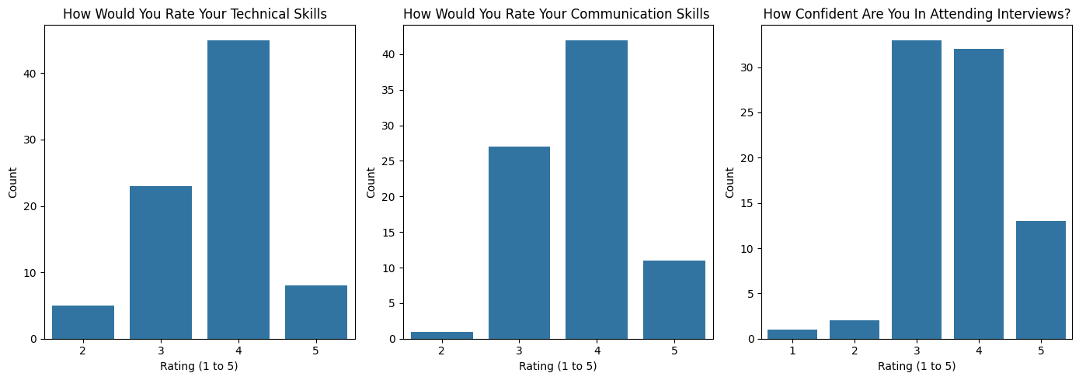
INSIGHTS AND INTERPRETATIONS Self-Rating of Key Employability Skills

Slide 7
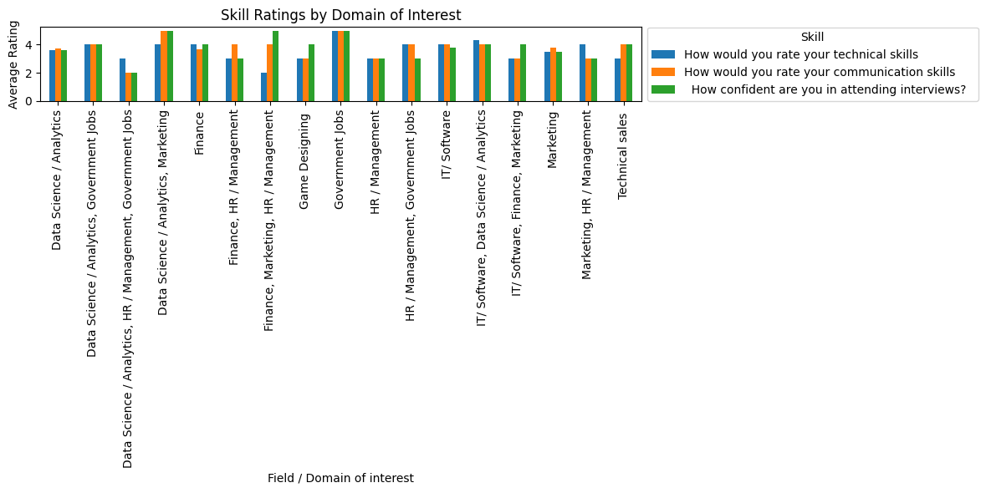
Overall Skill Ratings by Field of Interest

Slide 8
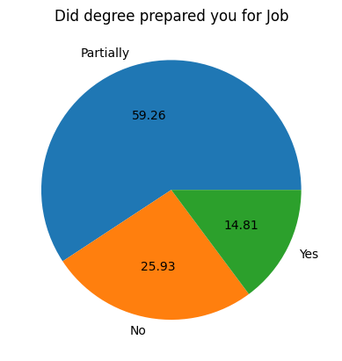
Perception of Degree’s Job Preparedness

Slide 9
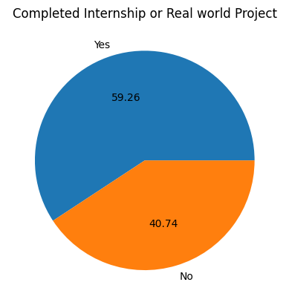
Participation in Internships or Real-World Projects

Slide 10
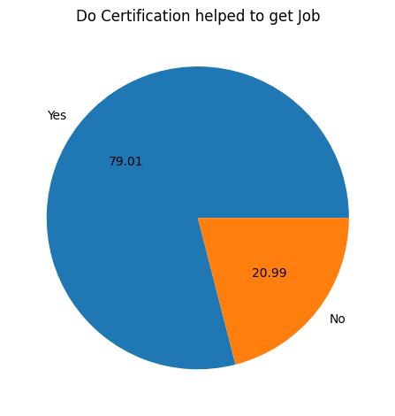
Impact of Certifications on Job Placement

Slide 11
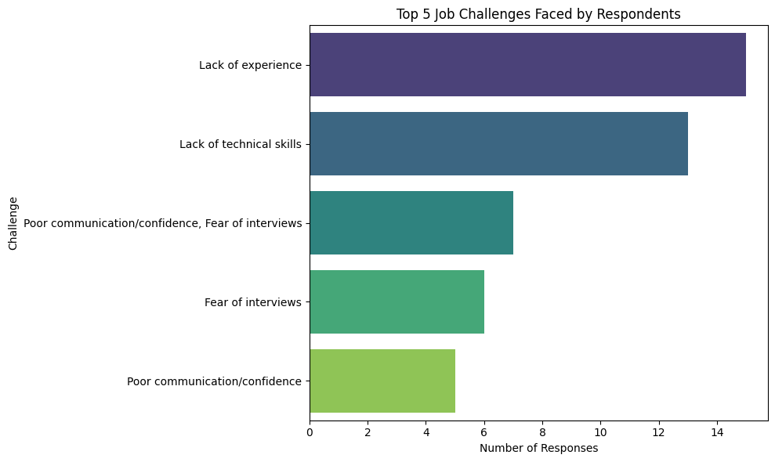
Top 5 Challenges Faced While Seeking Jobs

Slide 12
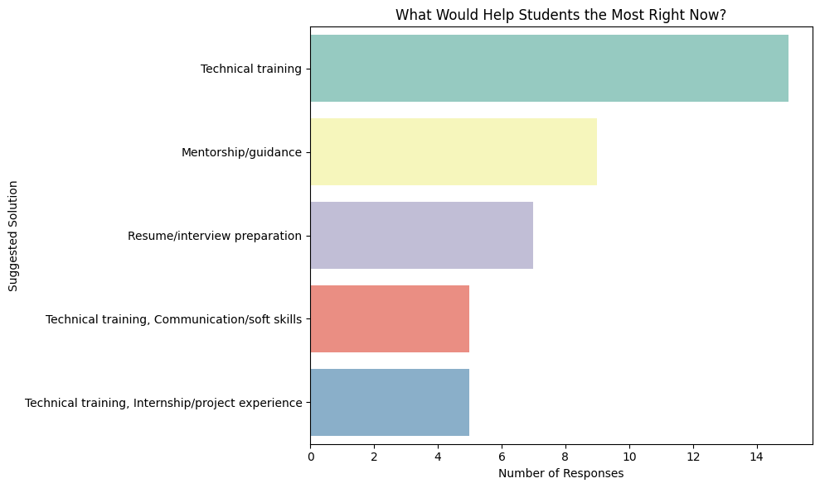
Student Recommendations for Career Support

Slide 13
CONCLUSION
The survey reveals that students face major hurdles in getting jobs, mainly due to a lack of technical skills, experience, and confidence during interviews. Communication gaps also limit their chances.
Students identified technical training, mentorship, and resume/interview preparation as top areas of support. These findings show a strong need for both technical and soft skill development.
A balanced approach that includes training, projects, internships, and soft skills can greatly enhance student employability and job readiness.

Slide 14
THANK YOU

